Slide 1

SUDS: Air Quality – Revealing Subscale Drivers of Pollution using Machine Learning
What are the drivers and impact of global ozone trends on global air quality at scales relevant to human health?
Transforming model bias into science insight
Earth
Started: November 2021
Science co-PI: Kazuyuki Miyazaki (329I), DS co-PI: Yuliya Marchetti (398J)
Team: Steven Lu (398J), Kevin Bowman (329G), James Montgomery (398J)
To increase the speed, depth, and rigor of scientific return
by revealing new connections through data science.
Notes:
Hello everyone, I am James Montgomery from the Machine Learning and Instrument Autonomy group 398J. Today I will be briefly talking about SUDS Air Quality – Revealing Subscale Drivers of Pollution using Machine Learning. The science question we’re asking is “What are the drivers and impact of global ozone trends on global air quality at scales relevant to human health?”

Slide 2

An Integrated Community of Practice for Science Understanding from Data Science
Initiative Leaders: Susan Owen (329) & Lukas Mandrake (398)

Slide 3
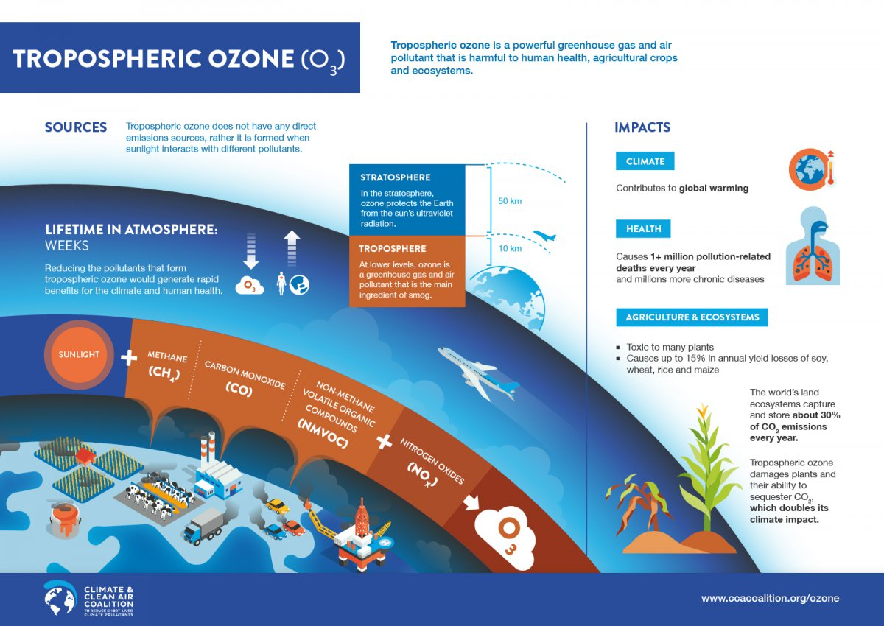
2017 Earth Science Decadal Survey “Understanding the changes in air pollutants”
Air quality from satellite data and model predictions remains elusive goal
Notes:
Our scientific objective is to provide an improved understanding and accurate prediction of the most important air pollutant: ozone. In the upper atmosphere, ozone protects the Earth from the sun’s UV radiation; however in the lowermost atmosphere, the troposphere, it is a greenhouse gas and air pollutant. As a result, ozone has substantial impacts on climate and human health, contributing to more than 1 million pollution related deaths every year. It also damages plants and vegetation and their ability to process CO2. The most recent NASA Decadal Survey noted that understanding the changes in air pollutants and ozone is one of the most important objectives and a recommendation for Explorer-Class missions. However, air quality study from satellite data remains challenging because of its limited sensitivity to near-surface air pollution.

Slide 4
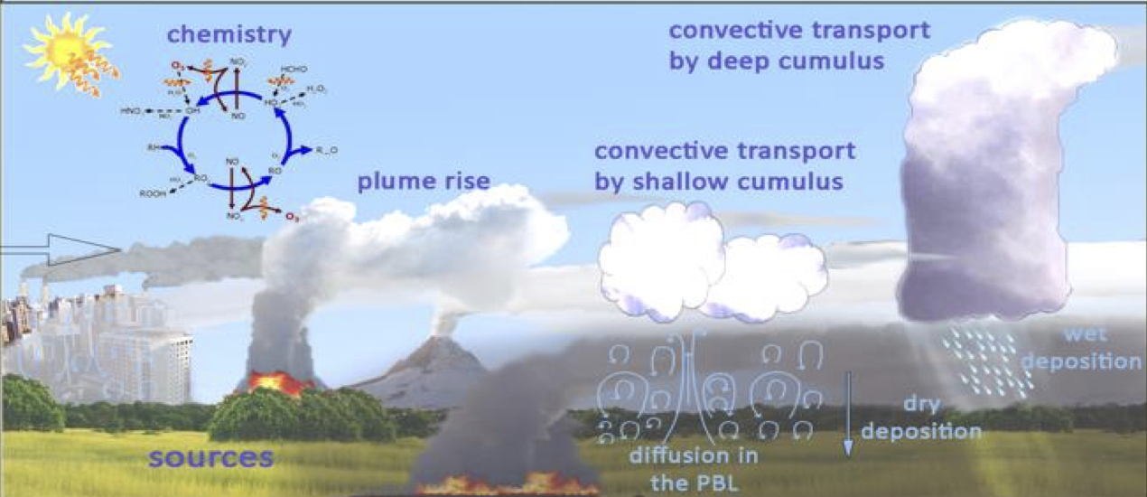
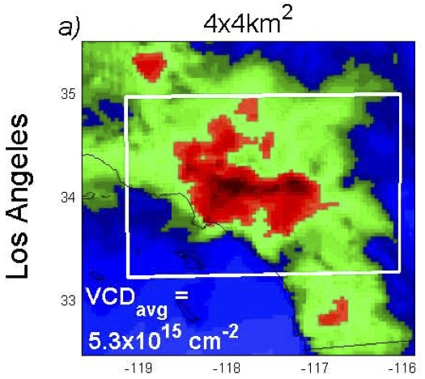
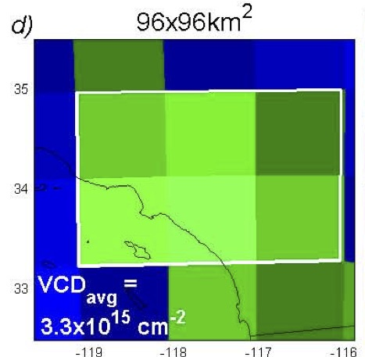
Complex system: challenging to accurately simulate ozone
Air pollution model prediction biases (=systematic errors) can be largely driven by both resolved (e.g., advection) and unresolved sub-grid scale processes
Chemistry
Air pollutant spatial gradients over LA
4 km resolution
100 km resolution
Planetary Boundary Layer (PBL) dynamics
−37 %
Physical
model grid
Emissions
⭐
⭐
-------------------- Sub-grid scale --------------------
Hypothesis 2: Strong spatial gradients in chemical regime coupled with PBL dynamics lead to bias patterns
Hypothesis 1: Air pollution prediction biases are largely driven by non-linear sub-grid processes
3
Notes:
So now we know ozone is super important to track. Unfortunately, simulating ozone is a very complex problem due to the chemical and physical mechanisms that contribute to ozone production. Due to this, we know our current knowledge suffers from substantial biases in model predictions. We hypothesize that air pollution prediction biases are largely driven by non-linear processes that occur at scales smaller than model grid points, the so-called unresolved sub-grid scale processes, in addition to grid-scale processes.
Current global models typically have several 100km horizontal resolution which cannot represent detailed small scale processes, such as urban chemistry and planetary boundary layer dynamics. For example, the figures on the right show the 100km resolution model is biased compared to the 4km resolution model when over an urban area. This leads us to hypothesize that strong spatial gradients in chemical regime coupled with PBL dynamics lead to bias in spatial patterns.

Slide 5
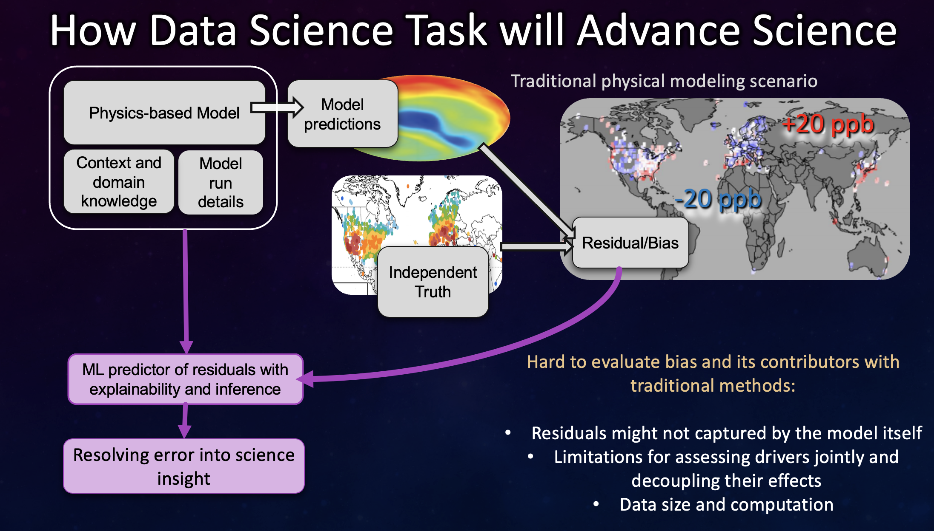

Slide 6
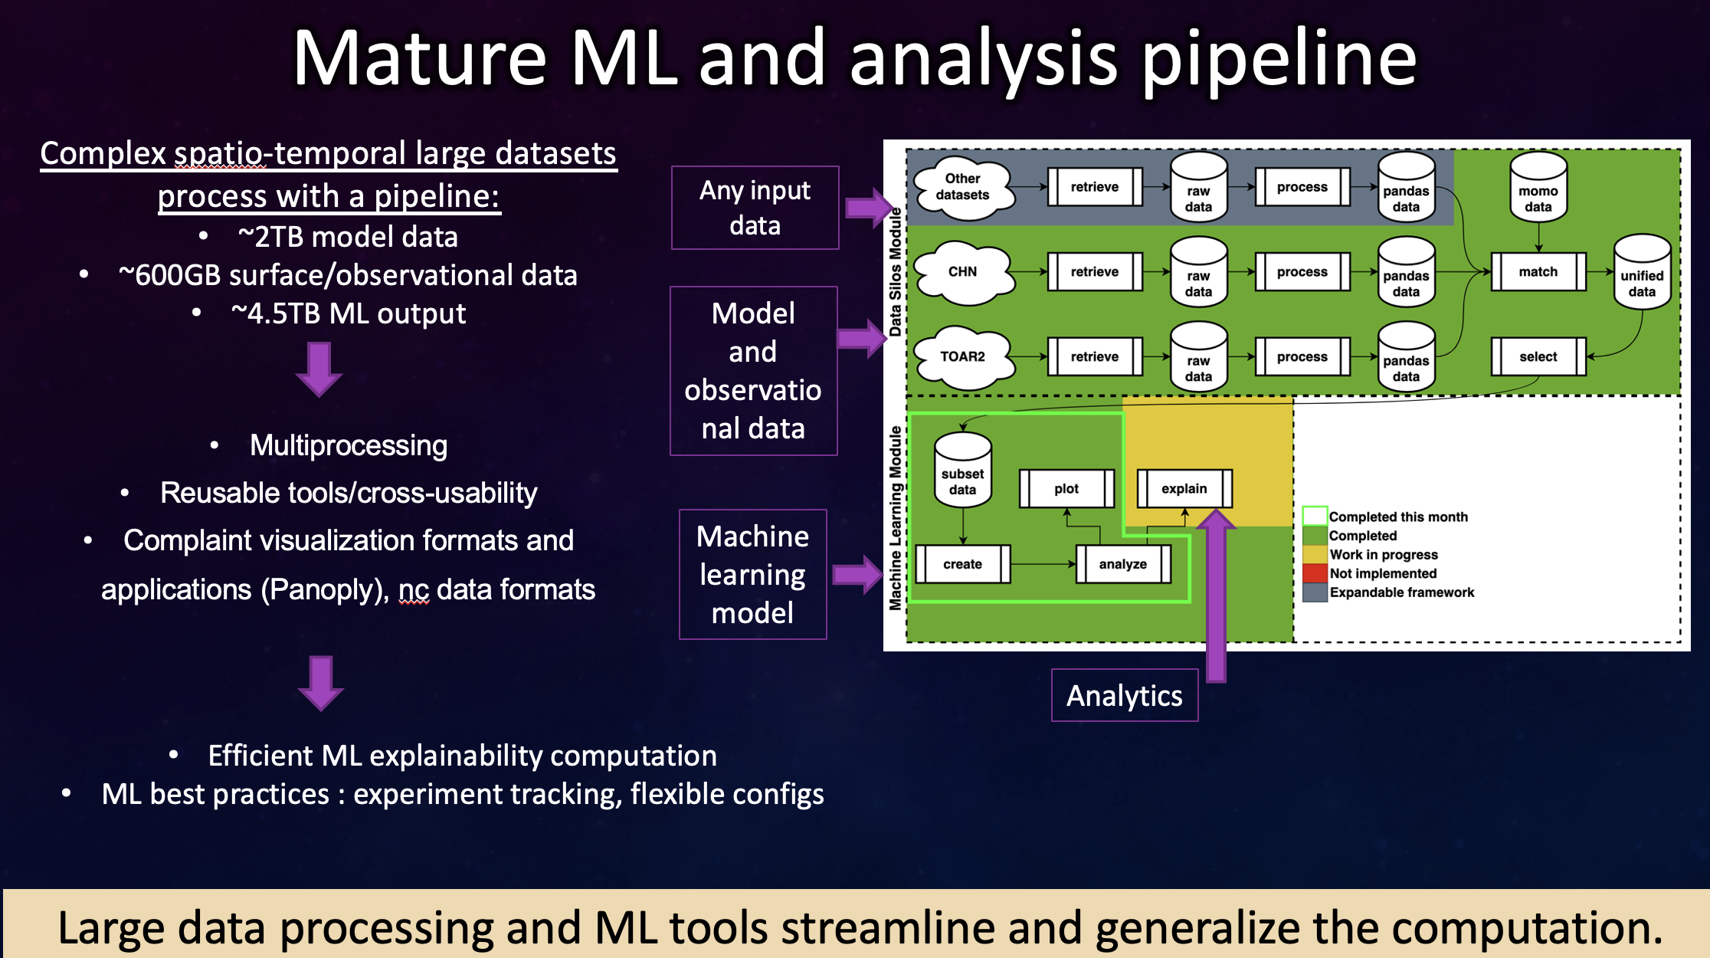

Slide 7
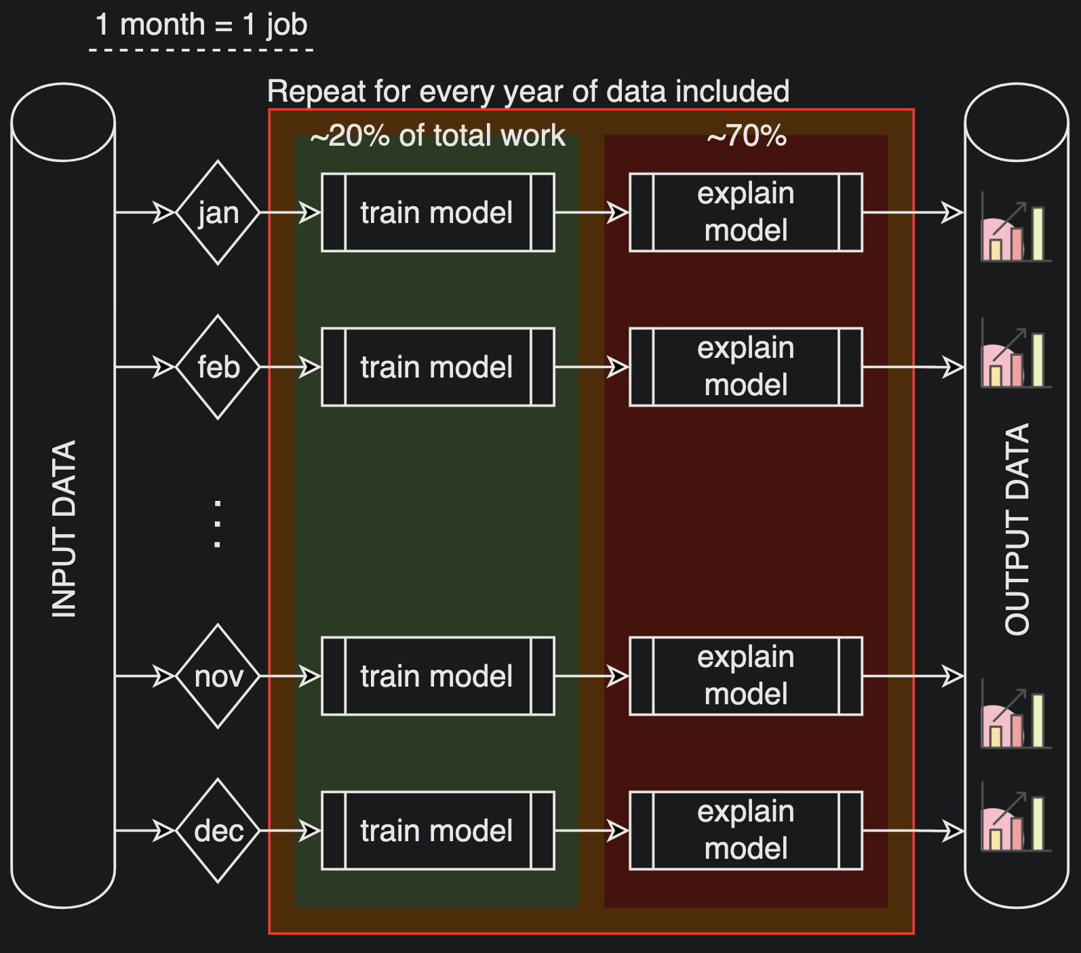
SUDSAQ on Gattaca
To capture seasonal trends we train months independently
Cuts down on data input
Split months into train/test pairs
Train 1 model for each year
Models train quickly but are computationally complex to explain
Data input ~20gb, output ~200gb
Models can be 100+gb

Slide 8
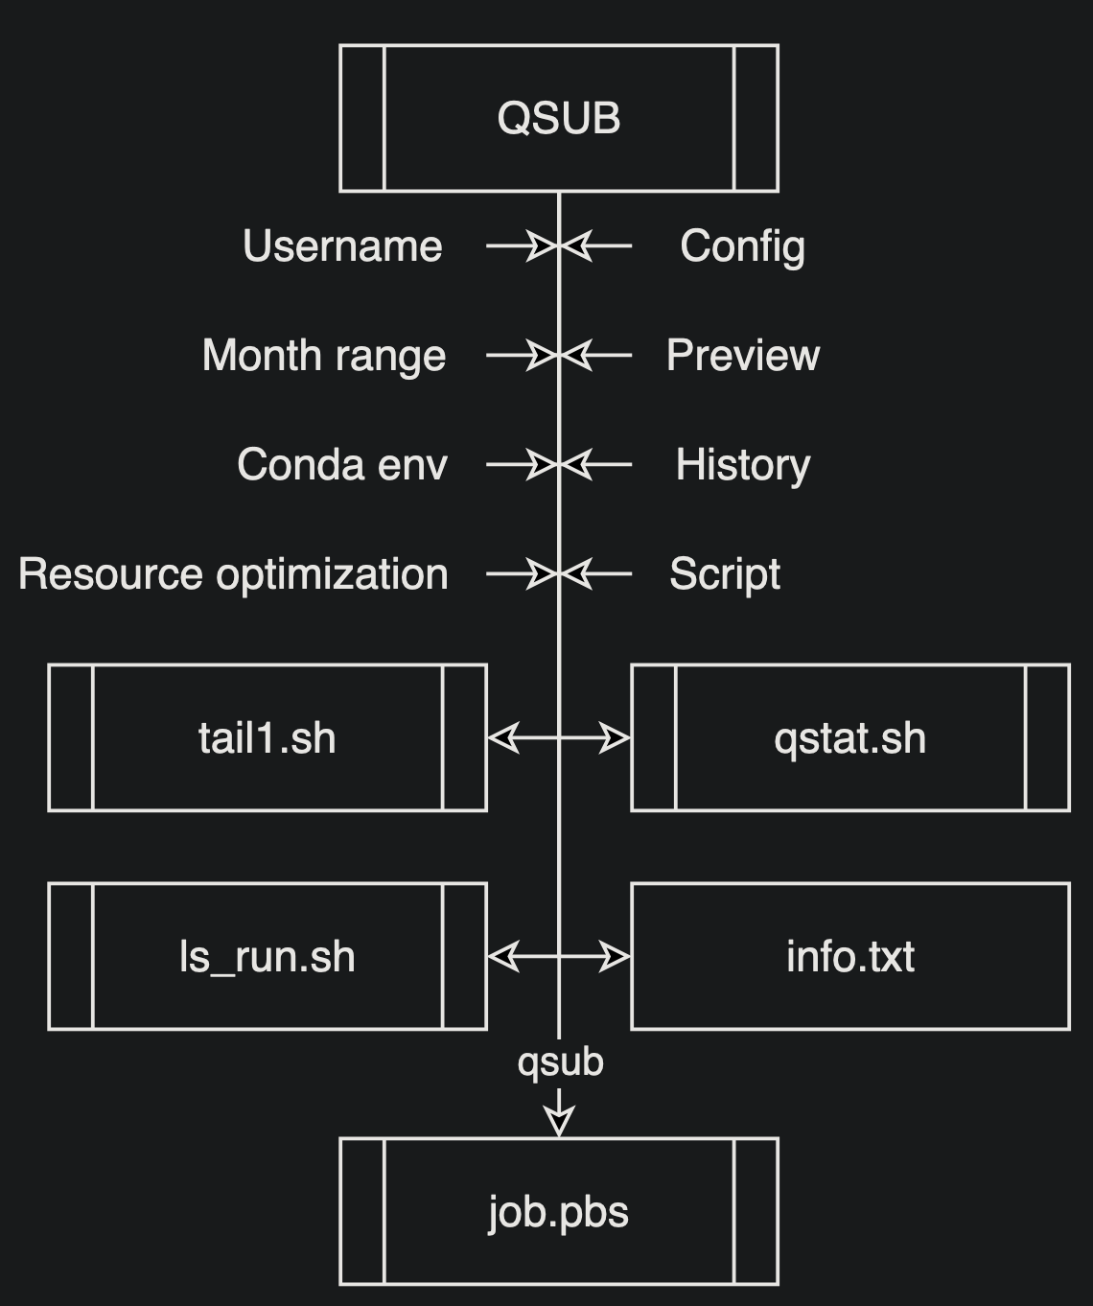
Next Steps on Gattaca
Created a qsub script that generates utility scripts and prepares for the output of a job
Begin leveraging Dask more
Datasets getting too large to fit even a single month in memory
Begin leveraging GPU processing
GPUs have been proven to be significant speed increases for machine learning, including model training and explanation methods

Slide 9
SUDS: Air Quality – Revealing Subscale Drivers of Pollution using Machine Learning
James Montgomery, 398J
J.Montgomery@jpl.nasa.gov

